Slide 1
Restaurant ETL Project
Product Engineering Project 1

Slide 2
Team Members
Scrum Master/Developer
Justin Quinn
Developer
Nick Fichera
Developer
Chi Asangwe

Slide 3



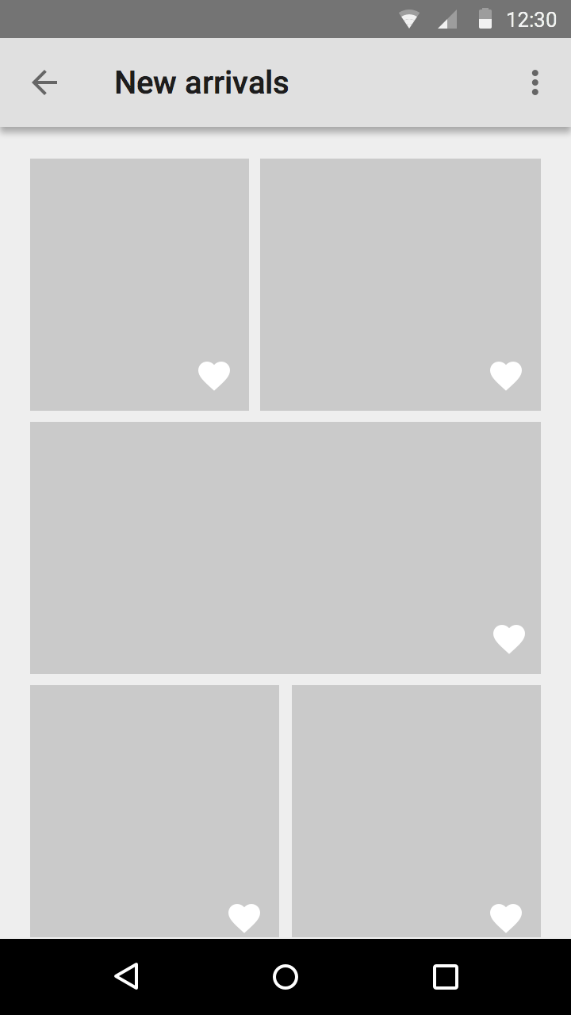
Restaurant Data Pipeline
As businesses constantly are collecting and storing data, anomalies may arise with the expansive dataset. To help combat this, our project will take company data about customers and orders, conduct a thorough examination, and remove anomalies, duplicates and redundancies. By doing so, we can provide the customer with a cleaned and transformed database which displays and makes use of originally unclean or erroneous data.

Slide 4
Objectives
Convert all data into dataframes
Work within dataframes to remove null, duplicate and outlier values
Merge files together
Design a database schema
Transport cleaned data from files into tables in the database

Slide 5
Checkpoint 1:
Convert Source Files to Dataframe Format

Slide 6
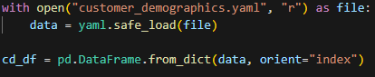
Requirements
Technology
Files
YAML & CSV files
Libraries
Pandas
Numpy
Databases
sqlite3
Process
Convert the yaml file
Assign it to a variable.

Slide 7
Checkpoint 2:
Cleaning the Data

Slide 8
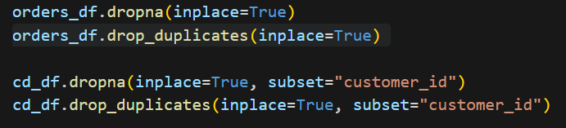
Nulls & Duplicates
Dealing with Nulls & Duplicates is necessary
Avoid inaccuracies (mean, median, etc) in analysis
Avoid distort visualizations. Interpret and communicate findings

Slide 9
Outliers
Interquartile Range [IQR]
The difference between the 75th and 25th percentile of data.
It measures the spread of the middle 50% of the data
Any data point that is more than 1.5 times the IQR above the 75th percentile , or below the 25th percentile is an outlier.
Z-score
By calculating how many standard deviations away each value is from the mean
Values that fall outside the 1.5 std. threshold are outliers

Slide 10
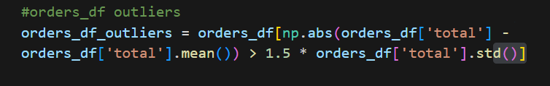
Outliers 2.0
Calculated the absolute difference between each value in the ‘total’ column and the mean of the ‘total’ column.
Then we check if the absolute difference is greater than 1.5 times the standard deviation of the ‘total’ column.
For now, we deal with them by assigning the rows where the condition/check is ‘True’

Slide 11
Problems
What method should we use to find outliers?
IQR
Z-score
Assumes normality
‘total’ in the ‘orders_df’ is appr. Normally distributed
When should we clean the data?
Before or after the Merge

Slide 12
Checkpoint 3:
Merging the Data

Slide 13
Challenges, Considerations, and Choices:
Cleaning the data before or after the merge had a large impact on how much data loss we saw: ~30% vs ~60%.
Based on customer needs to use the data for advertising purposes, we decided to err on a larger dataset.
Scrum Master’s Note: Singular issues such as this are often complex and multivariate. When considering workload distribution and discussing challenges, try not address more than one issue at once, as this can lead to confusion.

Slide 14
Checkpoint 4:
Database Schema and Setup

Slide 15
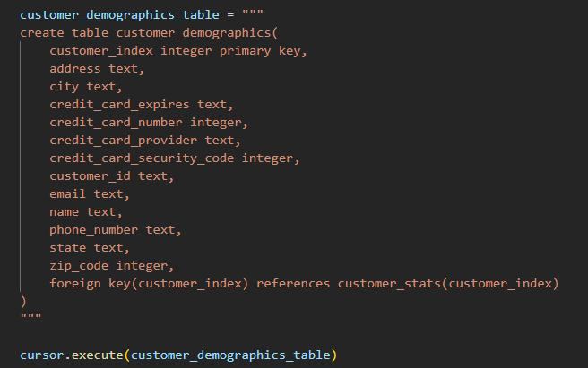
Database Schema
For the schema, we designed 3 tables for each of the three files of data. The database was created using sqlite. By creating necessary relationships and foreign keys, this allows the end user to view their data in a clean environment and to be able to draw connections between customers orders and their relevant contact information.
This table of customer’s personal information relates to information of that customer’s statistics through a foreign key.

Slide 16
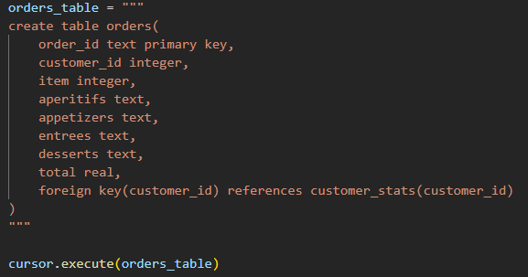
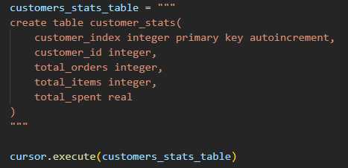
Database Customer Stats and Orders Schema
This table stores information about customers, such as their order total and money spent.
This table stores information about specific orders by a customer. A reference is made to the customers table to help the end user optimize their marketing to learn about the types of food certain customers may order.

Slide 17
Database Schema
These three tables provide the groundwork for the following features to succeed:
Providing detailed information about customer preference, patterns and orders or menu items that might be popular to help target a group of people.
Ability to evaluate trends or frequency of menu items ordered to help customize menu items or to remove or add items.
Ability to see real time sales or orders to help make data-driven decisions.
Ability to view clean, organized data to ensure accurate information to help make decisions.

Slide 18
Checkpoint 5:
Populating the Database from Data

Slide 19
Populating the Database
So, populating the database was pretty straight forward. After handling nulls or duplicates through in the dataframes, we can now load the clean, organized data into our tables. The end result provides the end user with a clean and organized database.
For example, our product requirements document outlines the following personas which will benefit:
The restaurant owner seeks a user-friendly database to view behavior of customers, menu orders and analytics about marketing to drive sales and operations.
The restaurant manager seeks to view day-to-day operations, inventory, and types of orders to make data-driven decisions.
In the end, we can verify that we are successful if:
A working database is setup with a schema with proper constraints
Data is correctly inserted into each table
No duplicates, null values or outliers exist in database

Slide 20
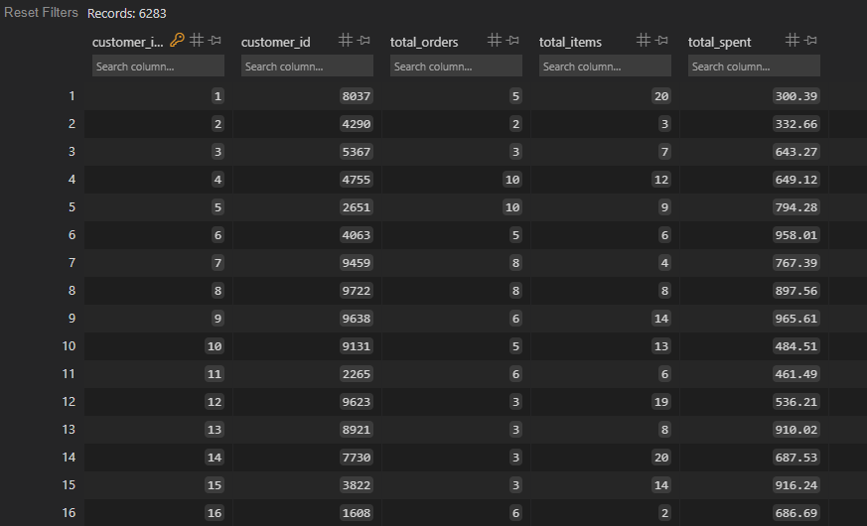
Visualization of Data
Customer Statistics Table Data

Slide 21
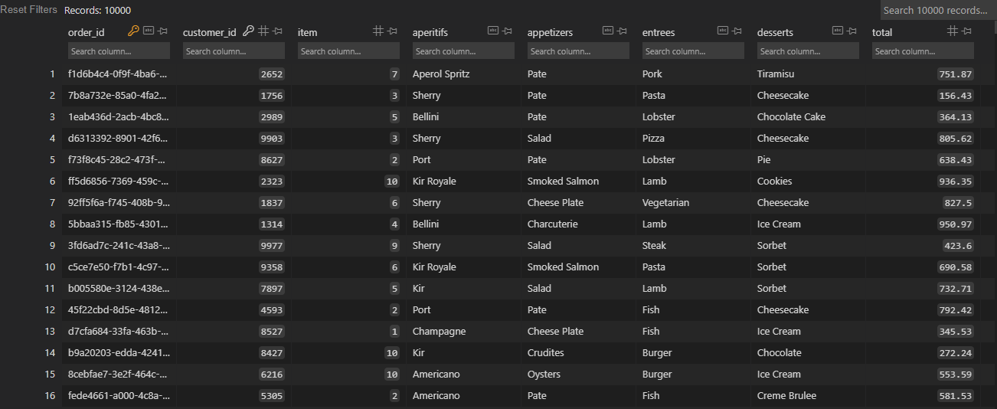
Visualization of Data
Orders Table Data

Slide 22
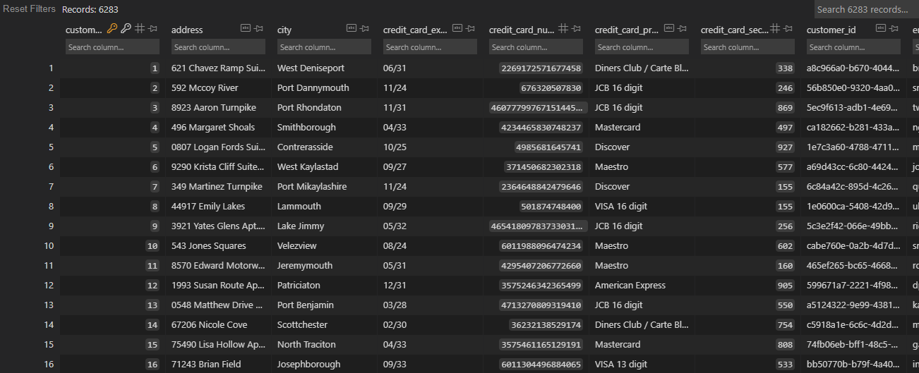
Visualization of Data
Customer Demographics Table Data

Slide 23
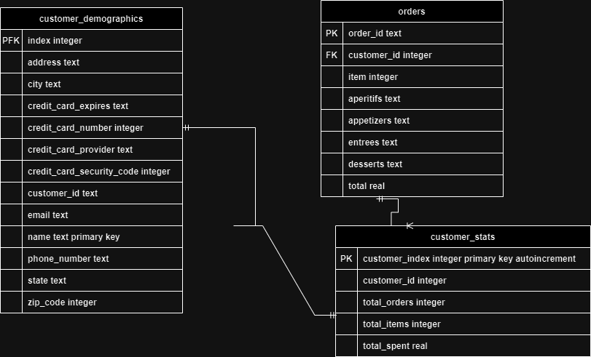
ER Diagram
Customer Stats to Customer Demographics has a One-to-One relationship.
Customer Stats to Orders has a One-to-Many relationship.

Slide 24
Checkpoint 6:
Data Analysis Report

Slide 25
Quality vs Quantity via Compare and Contrast
Things to keep in mind:
What is the goal of your analysis?
What specific patterns are you looking for?
How will discerning these patterns contribute to that goal?
What relationships between data are necessary to determine in order find those patterns?

Slide 26
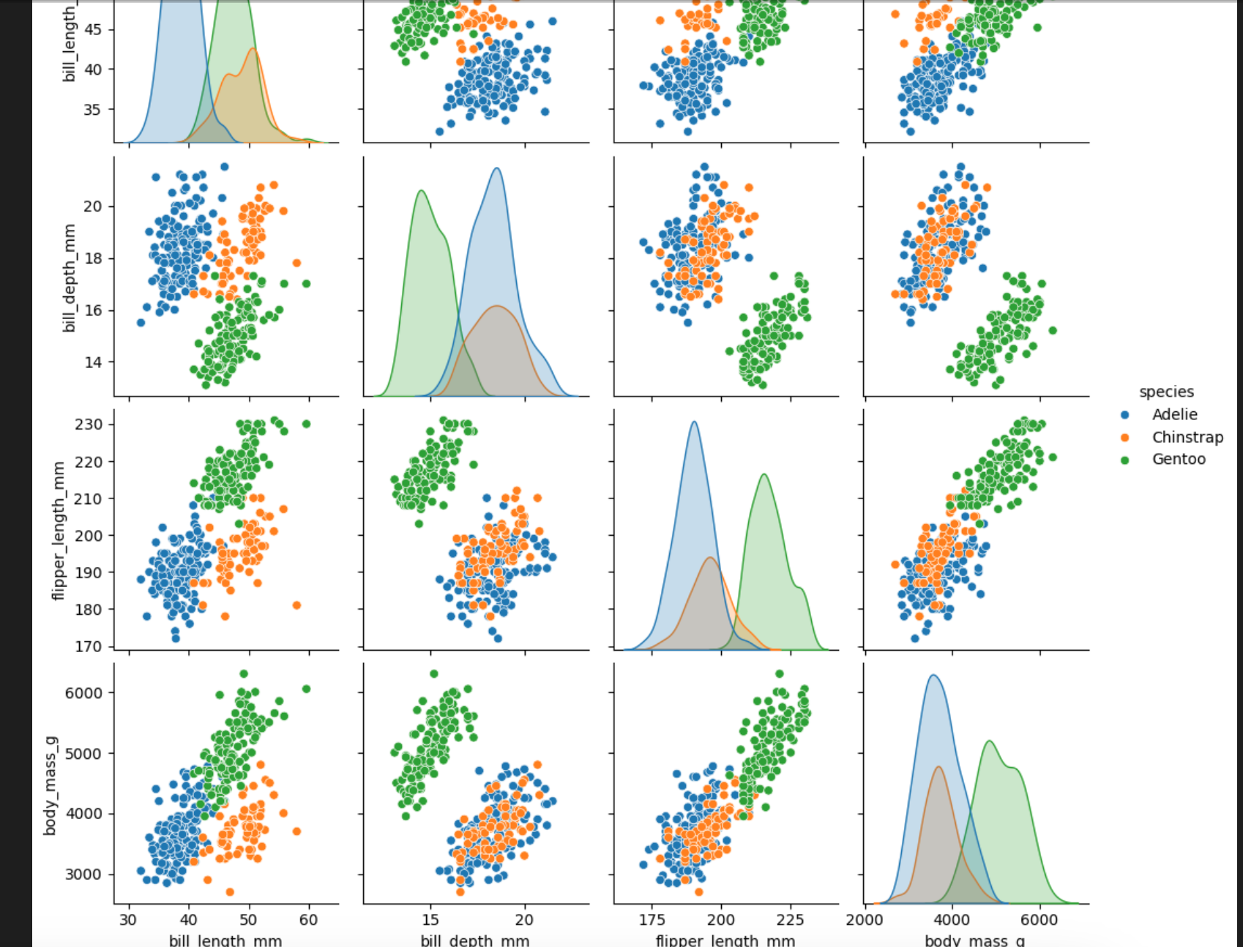
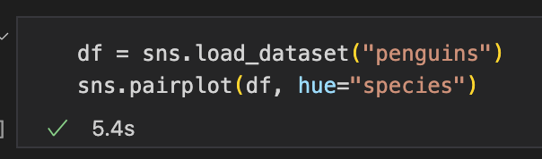
Seaborn Penguins Dataset
Expectations:

Slide 27
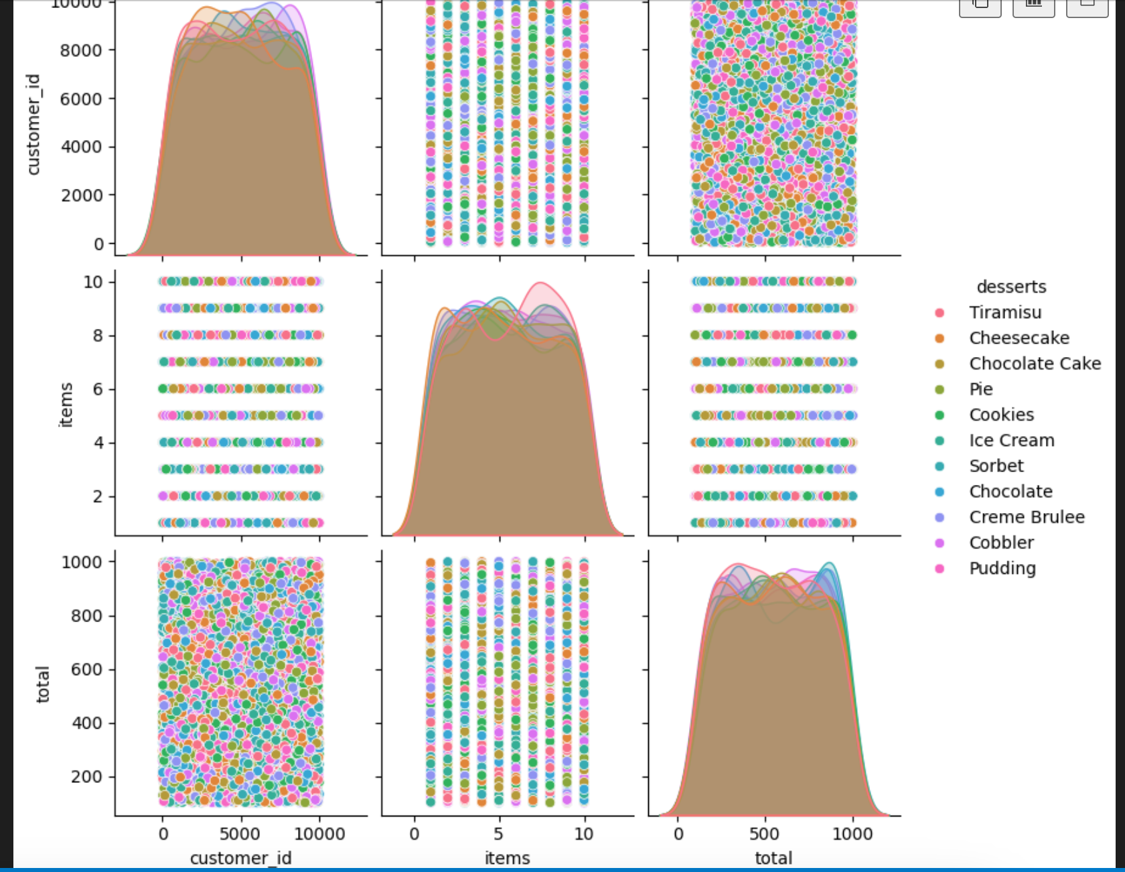
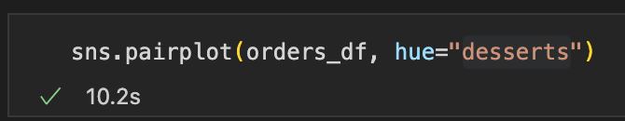
Orders Table: Desserts
Reality:

Slide 28
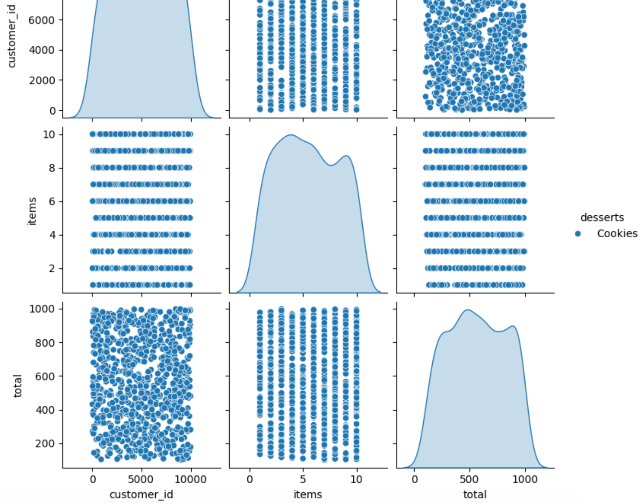
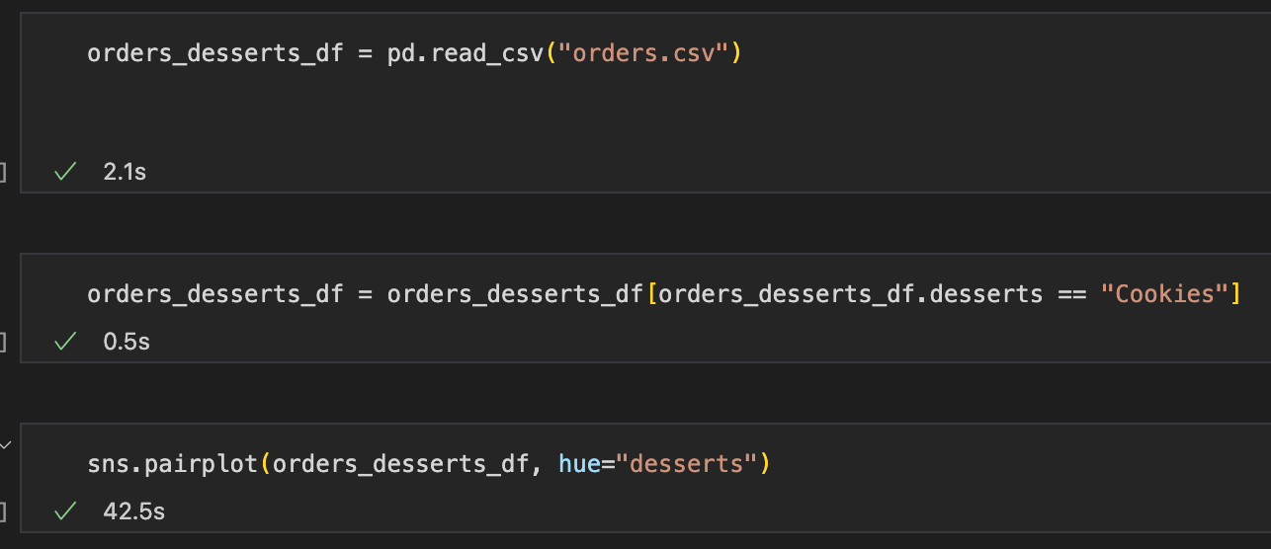
Attempts to Narrow the Data
*Sigh*

Slide 29
Next Sprint:
Data Security and Further Analysis

Slide 30

Data Privacy Considerations
Data contains sensitive credit card (cc) information
Vendors may collect cc data for advertising purposes
Organizations promoting credit card security:
Payment Card Industry Security Standards Council
Federal Trade Commission
Venders are encouraged to keep cc data only for as long a necessary for business purposes.

Slide 31
Recommendations to Improve Data Security
Define the parameters of how the data will be used for advertising purposes
Determine precisely which data are necessary, then securely discard the remainder within PCI DSS standards
Limit access to the database
Develop a protocol in case of security breach

Slide 32
Further Analysis
Additional merging, cleaning, and normalization of the data for more qualitative results
Explore the use of machine learning algorithms to do a more thorough numerical analysis on the data
The potential for AI to discover predictable purchasing patterns across long periods of time could prove invaluable to the client
Key First Step: Now that the basics of the data pipeline are set up, convene with the Product Owner to determine precisely what the customer wishes to learn from the data

